Slide 1
Templates and the Standard Template Library
Part I

Slide 2
What are templates?
For ADTs such as stacks and queues, it is the manner in which the data is stored (rather than the precise type of data stored) that defines the ADT and its interface.
The mechanism supporting genericity in C++ is the template construct.
This mechanism is important and powerful and is used throughout the Standard Template Library to achieve genericity.
Templates provide a means to reuse code –
one template definition can be used to create multiple instances of a function (or class), each operating on (storing) a different type of data.

Slide 3
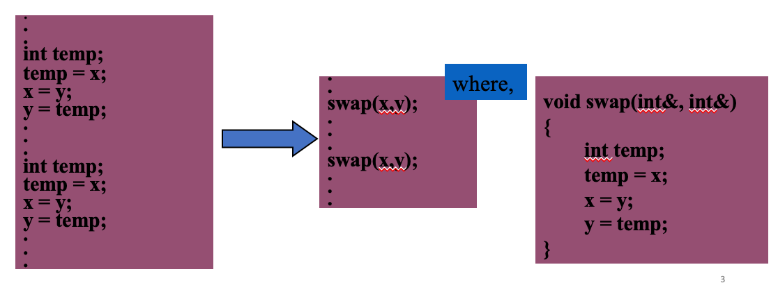
Function Genericity
Let’s say we want to swap the value of two integers ‘x’ and ‘y’
Few possible approaches:
Write inline code
Make the inline code into a function

Slide 4
Function Genericity
Now that we have a function to swap two ints, what if we want to write a function to swap two doubles.
Easiest approach might be to modify the earlier function by changing all int to double
Function overloading allows us to use the same name.

Slide 5
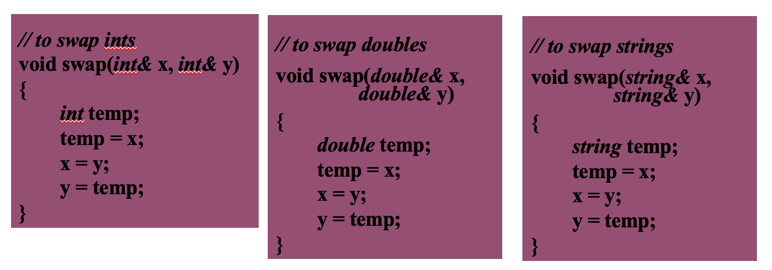
Function Genericity
Similarly, we can write any overloaded function to swap two strings or any other ADTs
A point to note is that the destructor, copy constructor and the assignment operator ‘=‘ should be defined/overloaded for the user defined ADTs specially if they member variables that are pointers.

Slide 6
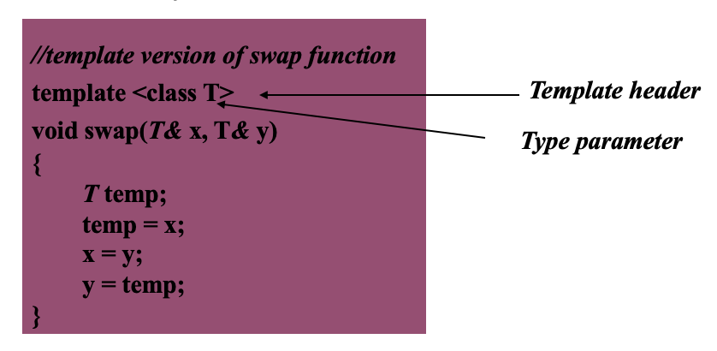
Function Genericity
The next stage then is to replace the data type with a placeholder. This placeholder is termed a type parameter and the technique/mechanism used is called a template function.

Slide 7
Function Genericity
More about function templates:
A function template is only a pattern that describes how individual functions can be constructed from given actual types. This process of constructing a function is called instantiation. In each instantiation, the type parameter is said to be bound to the actual type passed to it.
The template header gives two pieces of information to the compiler
The following code is a function template from which a function can be created (so just store it for now and don’t convert it to m/c instructions)
The identifier (here, T) is the name of the type parameter for this function template that will be given a value when the function is called.
A function template can have more than one type parameter.

Slide 8
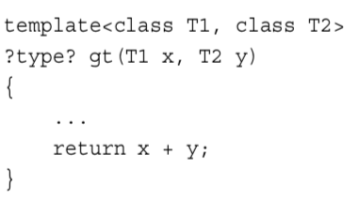
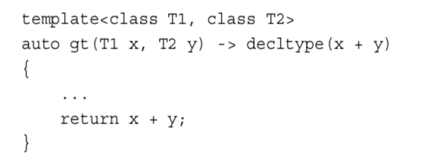
New to C++ 11
The decltype Keyword
int x,y;
decltype(x+y) xy = x + y
Alternative Function Syntax – Trailing Return Type

Slide 9
Class Genericity
Container classes like Stack, Queue, etc. might be needed to store any kind of data type and lend themselves to template implementations quite naturally.
The next slide shows a few approaches to enable creation of stack of different data types.

Slide 10
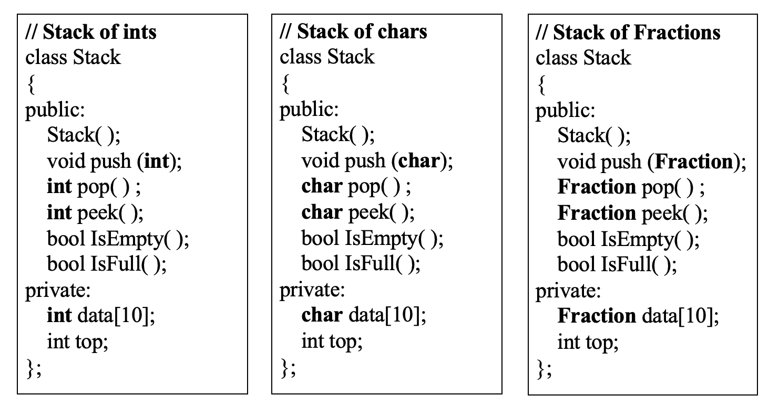
Class Genericity
Using ordinary classes

Slide 11
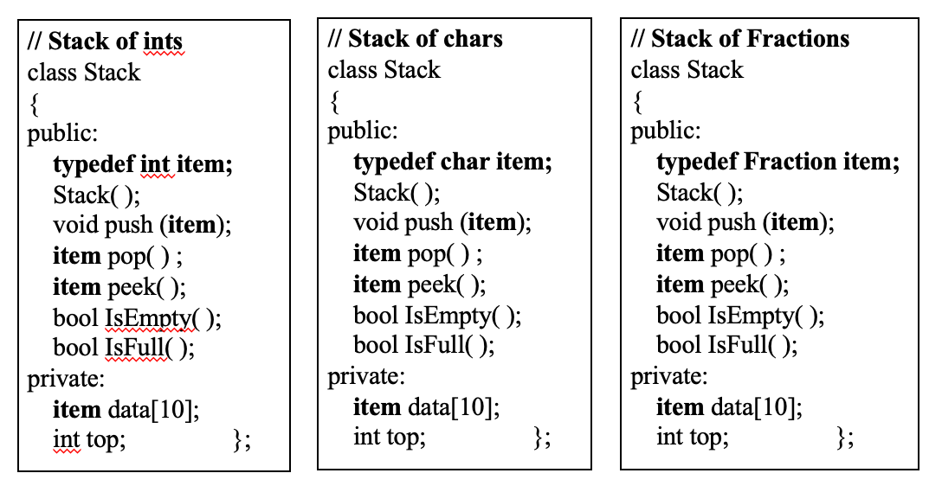
Class Genericity
Using a typedef statement in class definition
reduces amount of code to modify

Slide 12
Class Genericity
Thus, we see even though using a typedef statement greatly reduces the code to be modified we still have to write three classes to be able to have a stack of ints, chars and Fractions.
Moreover, if we have to use them in the same program, either we’ve to change their name or put them in different namespaces.
A better solution is to use templates.

Slide 13
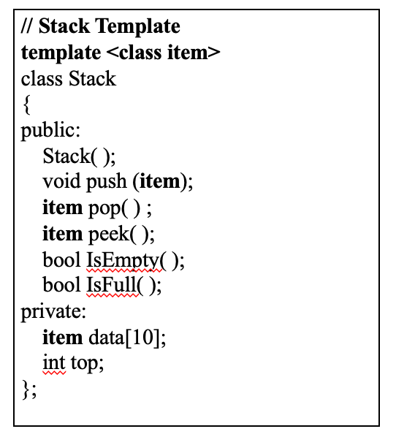
Class Genericity
Using a template class

Slide 14
Class Genericity
More about class templates:
A class template is only a pattern that describes how a class can be constructed at the time of instantiation
The template header gives two pieces of information to the compiler
The following code is a class template from which a class can be created (thus, just store it for now and don’t convert it to m/c instructions)
The identifier (here, T) is the name of the type parameter for this class template and will be given value at time of instantiation

Slide 15
Class Genericity
Three important rules that govern building class templates:
All operations defined outside of the class declaration must be template functions
Any use of the name of the template class as a type must be parameterized
Operation on a template class should be defined in the same file as the class declaration

Slide 16
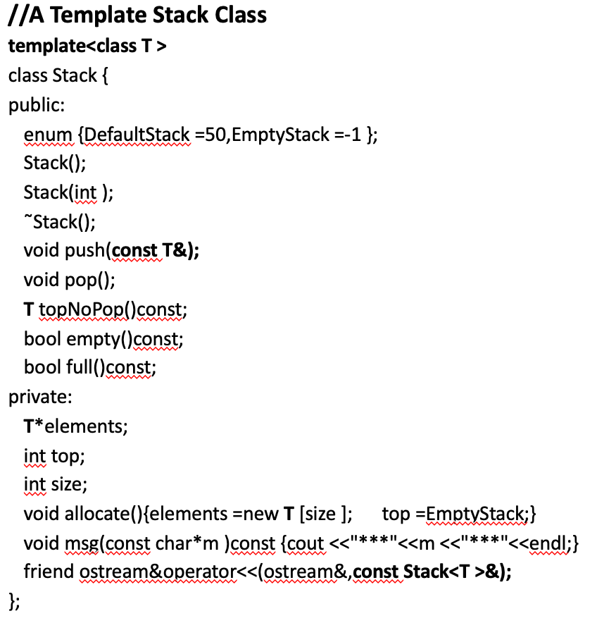
Stack Program using Dynamic Array

Slide 17
template<class T >
Stack<T >::Stack(){size =DefaultStack; allocate(); }
template<class T >
Stack<T >::Stack(int s ){if (s <0) s*=-1;
else if (s==0 ) s =DefaultStack;
size =s; allocate(); }
template<class T >
Stack<T >:: ˜Stack(){delete []elements;}
template<class T >
void Stack<T >:: push(const T&e ){assert(!full());
if (!full())elements [++top ]=e;
else msg("Stack full!");}
template<class T >
void Stack<T >::pop(){assert(!empty());
if (!empty()) top--;
else { msg("Stack empty!");}}
Contd.

Slide 18
template<class T >
T Stack<T >::topNoPop()const {assert(top >EmptyStack );
if (!empty())return elements [top ];
else {msg("Stack empty!");
T dummy_value; return dummy_value;}}
template<class T >
bool Stack<T >::empty()const {return top <=EmptyStack;}
template<class T >
bool Stack<T >::full()const {return top +1>=size;}
template<class T >
ostream&operator<<(ostream&os,const Stack<T >&s ){
s.msg("Stack contents:");
int =s.top;
while (t>s.EmptyStack )cout <<s.elements [t--]<<endl;
return os;}

Slide 19
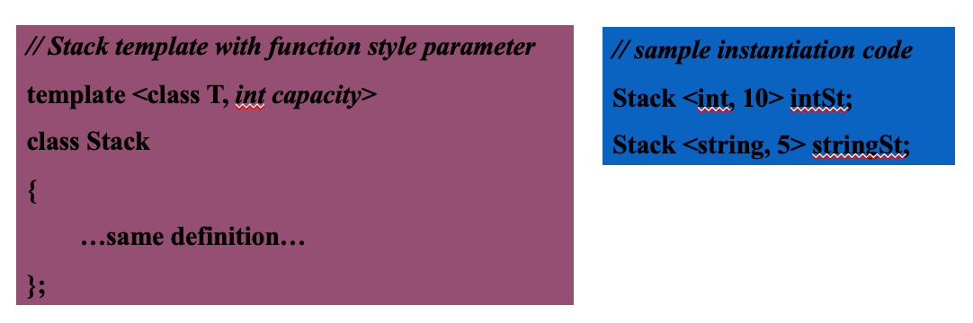
Class Genericity
In addition to at least one class parameter (can be more than one), a template class can also use a function style parameter.
The function style parameter ‘capacity’ in the following implementation of the stack class allows the user to specify the size of the stack at the time of instantiation.

Slide 20
Summary
Templates make it possible for classes and functions to receive not only data values to be stored or operated on via parameter but also to receive the type of data via a parameter.
Templates go a long way in creating generic code and promoting code reuse.

